Slide 1
Agent Skills
Agentic Coding for Geospatial
Ujaval Gandhi
Spatial Thoughts
ujaval@spatialthoughts.com

Slide 2
What is a Skill?
Skills are a set of instructions that teach an AI agent how to perform specific, multi-step workflows.
Skills are defined by a SKILL.md containing natural-language instructions for the agent along with specific examples and patterns.
You can also publish your skill on GitHub and make it available for others to download and use with their own agent.

Slide 3
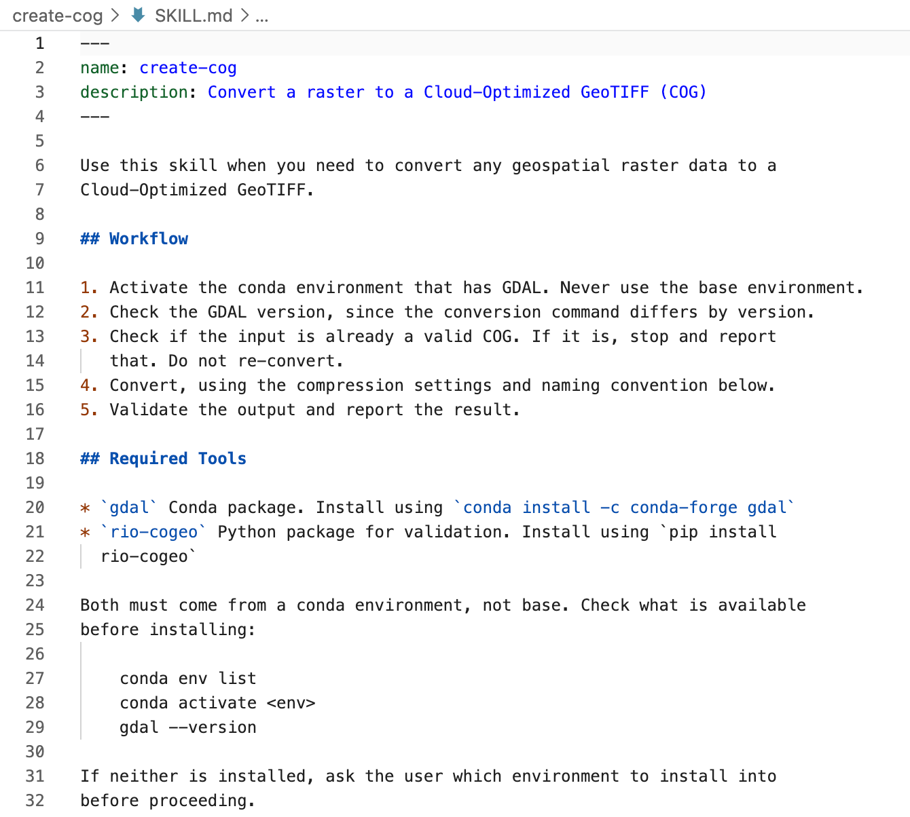
Skills are just Markdown files
A folder containing SKILL.md file with instructions on how to complete task.
The folder may also contain scripts and templates referred by the SKILL.md file.
Skills are automatically loaded when a prompt or user intent matches the description of the skill.
Optionally, you can invoke the skill using a command - using the skill name. i.e. /create-cog
Commands

Slide 4
When to use Skills?
Skills range for simple instructions to complex workflows.
Use skills to change or guide model behavior.
Many users have created skills with instructions for the AI model to tailor its output for specific purposes. [Example]
Use skills to automate a workflow.
Take any repeated multi-step task and create a skill to automate it. [Example]
Use skills to ensure adherence to a specific coding pattern.
Encapsulate your preferences with examples [Example]

Slide 5
Useful Skills
Anthropic Official Skills: Official skills repository by Anthropic. skill-creator, pdf, xlsx are useful skills for Data Science work.
Skills Leaderboard: Discover, install and manage skills using the skills CLI.
Geospatial Skills for Agents: A catalog of installable geospatial tools and capabilities designed for coding agents, covering raster/vector processing, satellite data, and interactive visualization.
SpatialThoughts AI Skills: Repository containing skills accompanied with Spatial Thoughts Courses.
GeoSQL: Skill for data scientists and analysts working with geospatial data on PostGIS, BigQuery, Snowflake, and Wherobots.

